Slide 1
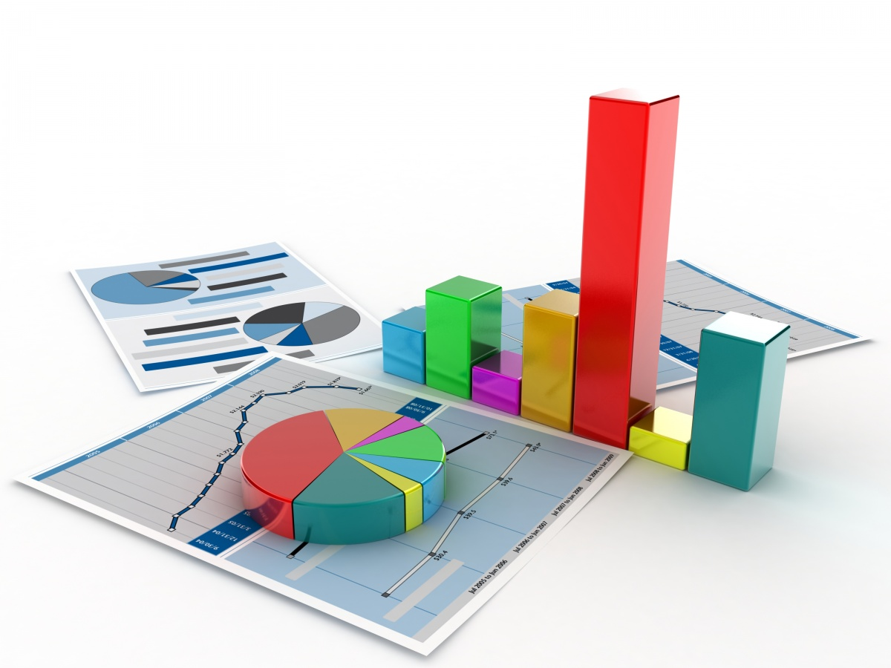

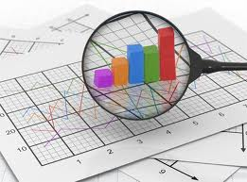
Course Introduction
Business Analytics, Review
Business Analytics
Graduate Program

Slide 2


Learning Objectives / Topics
Supervised Learning Examples
Unsupervised Learning Examples
Visualization Examples
Introductory Background Ideas
Business Analytics Intro Experiments
AMD Beta
Multiple Regression Analysis

Slide 3




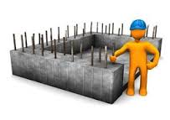
Business Analytics Breakdown & Organization
Linear and nonlinear optimization models, Decision analysis models
Prescriptive
Analytics
Predictive
Analytics
Monte Carlo Analysis
Visualizations
Supervised
Learning
Data Mining
Descriptive
Analytics
Unsupervised
Learning
Standard Reporting
Data Queries
Basic Statistics
Statistical Foundation Concepts

Slide 4


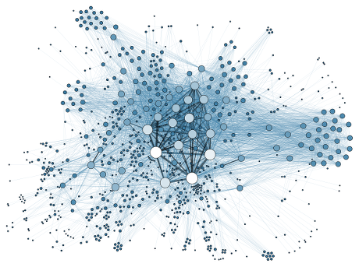
Predictive Analytics Data Mining
Predictive
Analytics
Supervised Learning
Target/Outcome Variable
Using the data attributes/features to predict the target
We have known targets from historical data
Common Supervised learning methods:
Regression analysis
Logistic regression, Decision trees, Decision forests,
Support vector machines, Neural networks, Naïve Bayes
Data Mining
Regression Analysis
Categorical
Classification Analysis
Decision/Classification Trees
Logistic regression
no
yes
Unsupervised Learning
No Target/Outcome Variable
Discover relationships/patterns among “instances” based on “features”
Discovering which observations tend to group together
“Predicting” class/group membership
Common unsupervised learning methods:
K-means cluster analysis, association rules, market basket analysis
Cluster Analysis
k-means

Slide 5
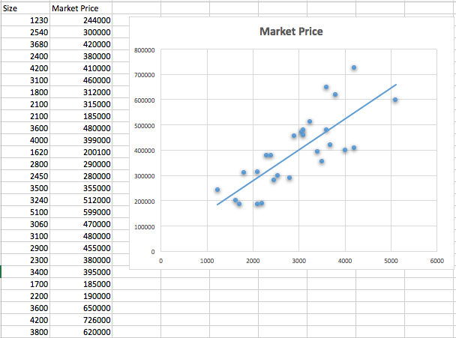
Supervised Learning, Continuous Target Simple Linear Regression
Predictive
Analytics
In SLR Analysis your prediction model is a line.

Slide 6
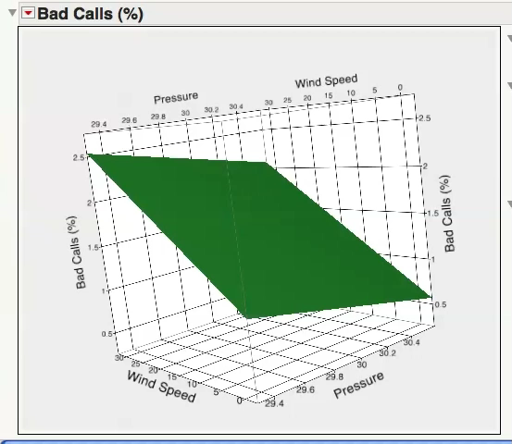

Supervised Learning, Regression Analysis Prediction Space is a Plane
Predictive
Analytics
Built this using

Slide 7
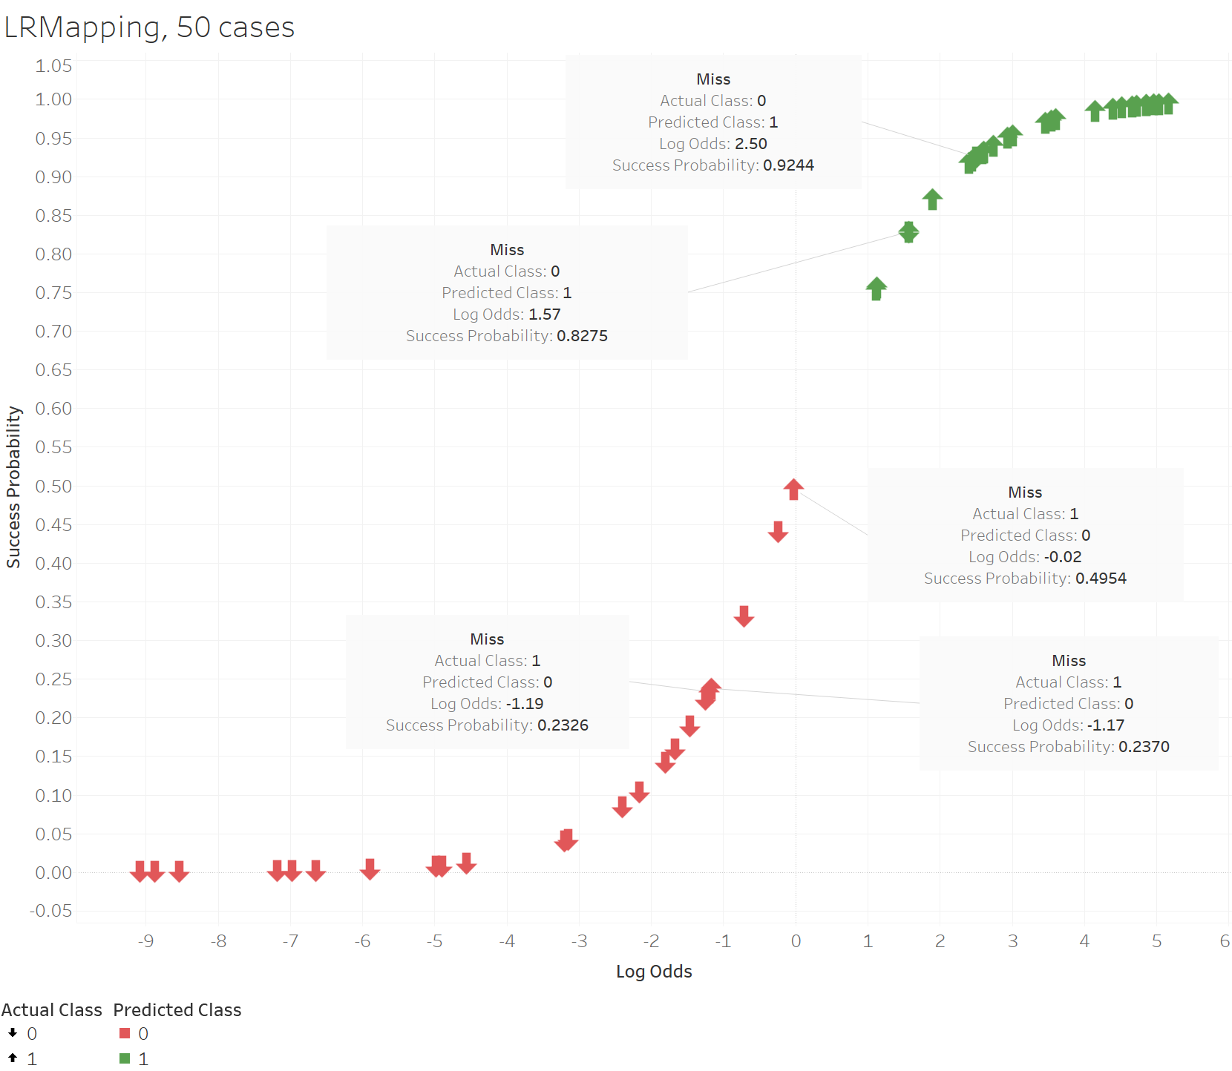
Supervised Learning, Logistic Regression Prediction Space is a S Curve
Predictive
Analytics

Slide 8
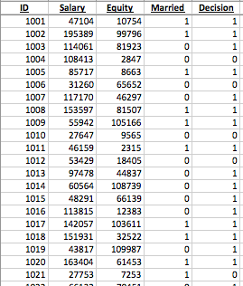
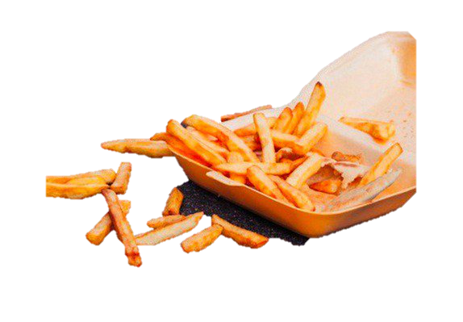
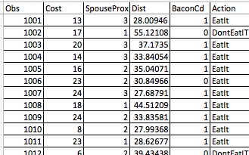
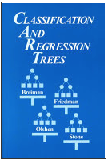


Decision Tree Analysis Supervised Learning, Target (outcome variable) is Categorical
Predictive
Analytics
Did your wife see you?
YES
NO
Was it expensive?
Eat It
YES
NO
Can you cut off the part that touched the floor?
Is it bacon?
YES
NO
YES
NO
Don’t
Don’t Eat It
Eat It
Eat It
Eat It
ML, Common Supervised Learning Methods
Regression analysis (equation ➔ estimated target value)
Logistic regression (equation ➔ probabilities)
Decision trees
Support vector machines
Neural networks
Naïve Bayes
Categorical Target

Slide 9

Decision / Classification Tree Application The Business Issues
Predictive
Analytics
Over the past two years there has been a lot of turnover in our bank, especially with our loan analysts. Our loan default continues to be significantly better than our competitors. We have done a great job in the past approving or denying applicants, but with our new and relatively inexperienced personnel, we want to make sure we continue to be as effective as possible. Can we leverage the work that has been done in the past?
3 features
target
label
550 instances
3 features
1 label or target
550 instances where the correct decision was made.

Slide 10

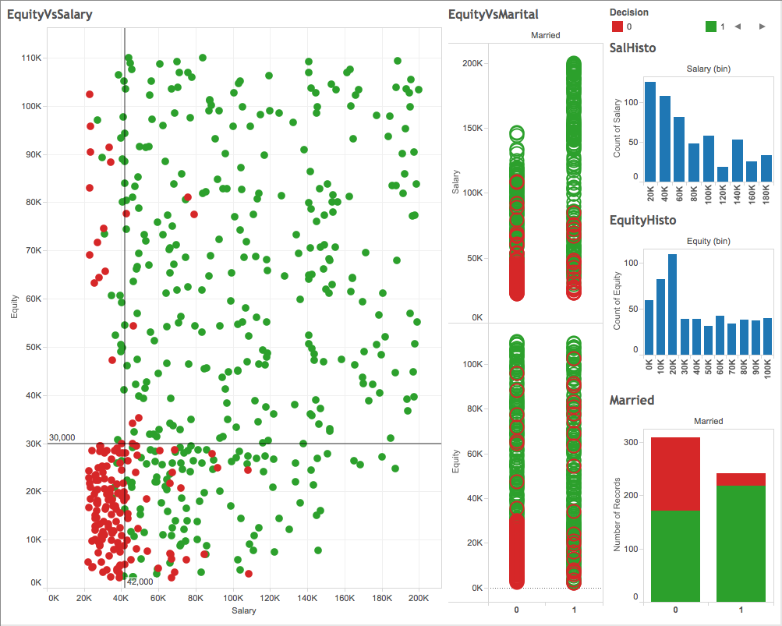
Decision / Classification Tree Application Visualizing The Raw Data
Descriptive
Analytics

Slide 11
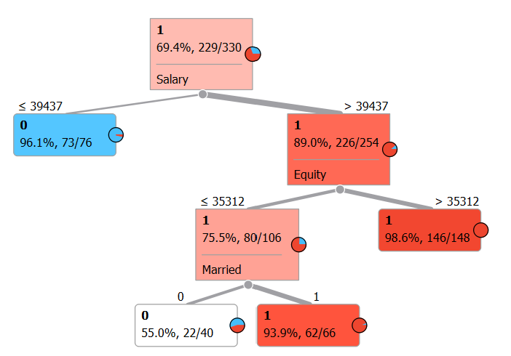
Interpret the Results
Predictive
Analytics

Slide 12
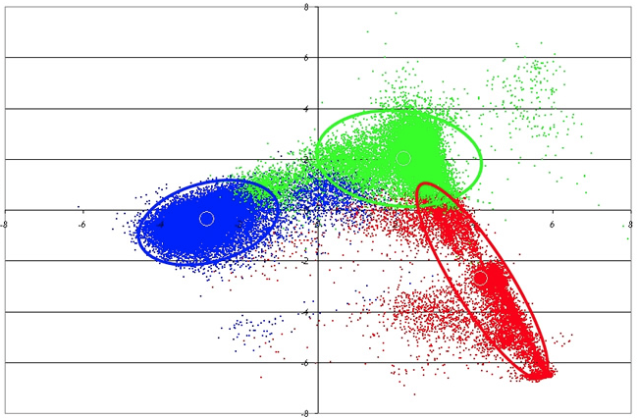
Cluster Analysis Unsupervised Learning
Predictive
Analytics
reliability performance
lead time performance

Slide 13
Cluster Analysis Application The Business Issues
Predictive
Analytics
We are constantly redeploying our support resources without any strategy or direction. Our support department has grown overall and is over budget. We don’t know if this growth is useful. Customer complaints are increasing overall.
Revenues have been increasing, yet profitability has been flat.
Marketing feels it does not understand the customer base and where to allocate resources. For instance, which customers should be handled with special care? Which customers should receive more support? Are we spending too much time with some customers?
414 instances
3 features
No target / label

Slide 14
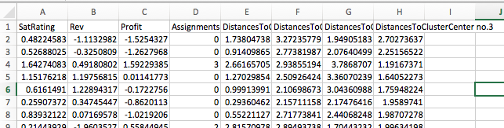
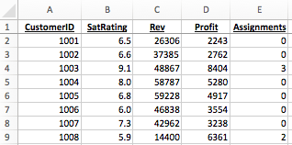
Cluster Analysis Visually Interpret the Results
Predictive
Analytics

Slide 15
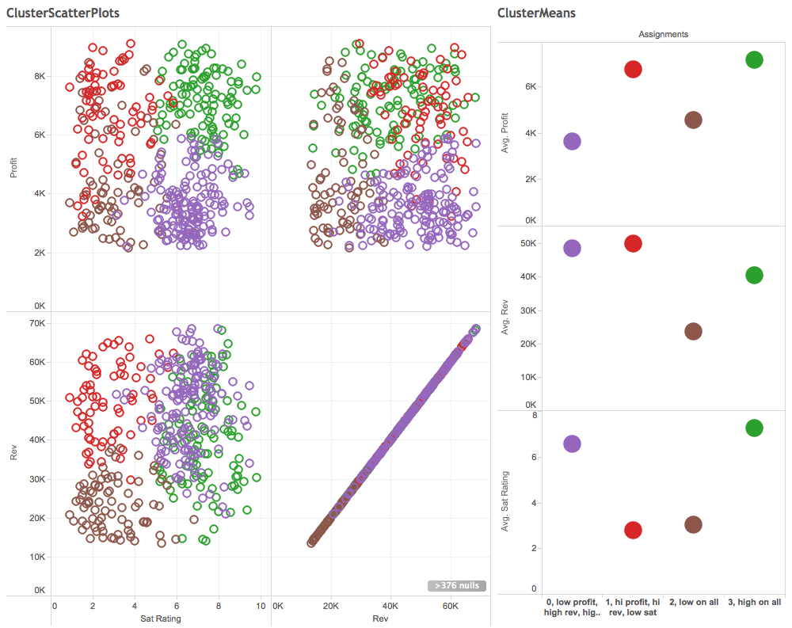
Cluster Analysis Visually Interpret the Results
Predictive
Analytics

Slide 16
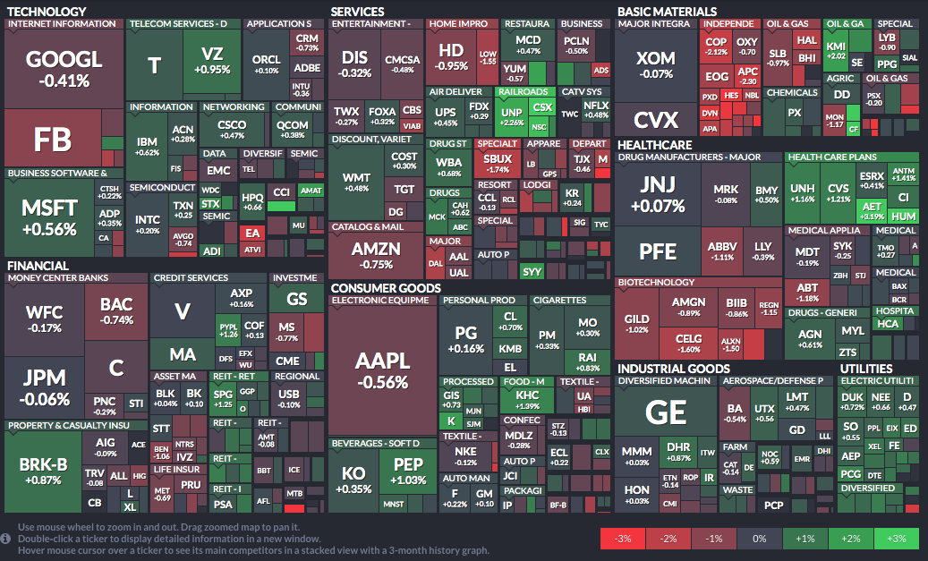

Heat Map
Visualizations

Slide 17
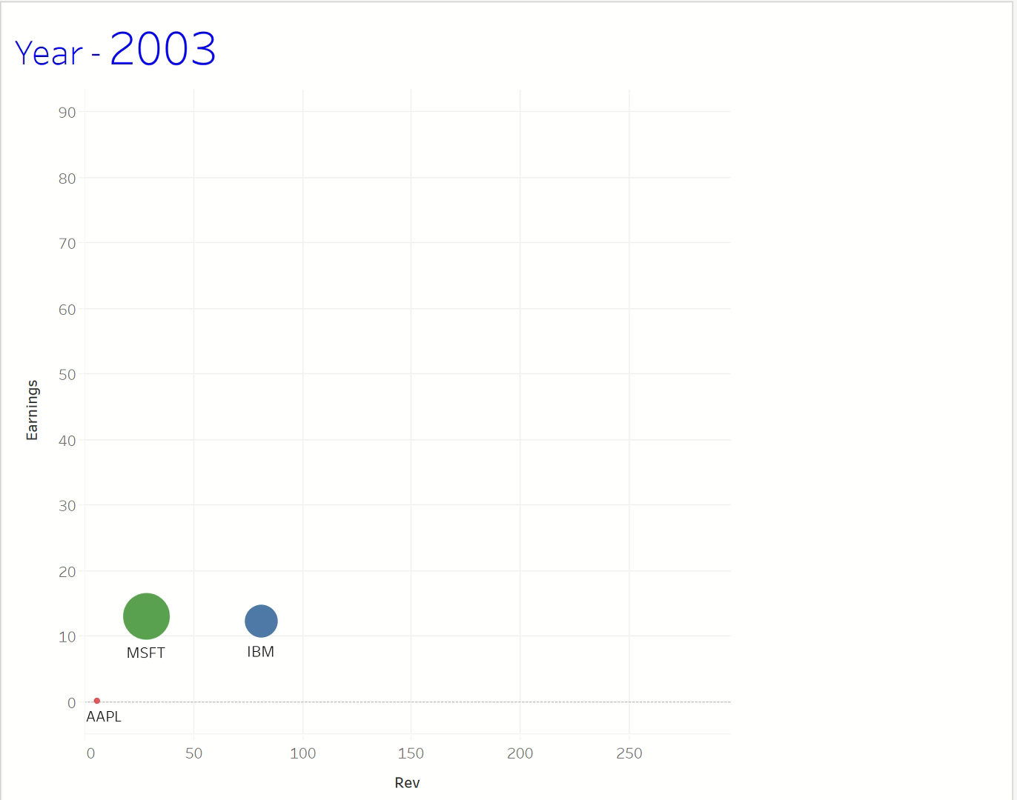
Motion Bubble Chart AAPL, MSFT, IBM
Visualizations

Slide 18
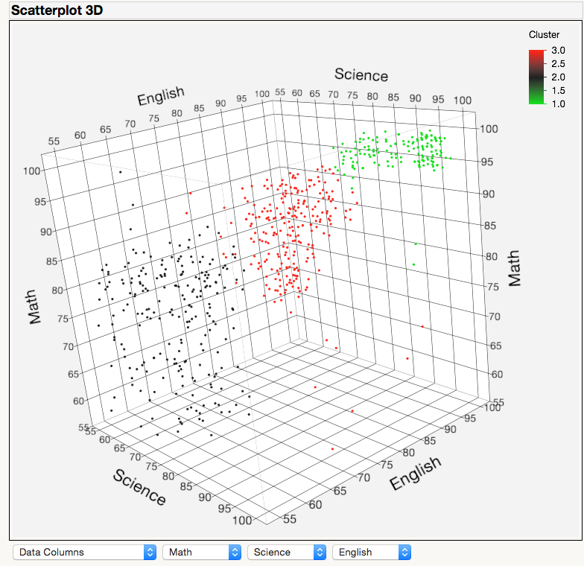
Cluster Analysis
Visualizations

Slide 19


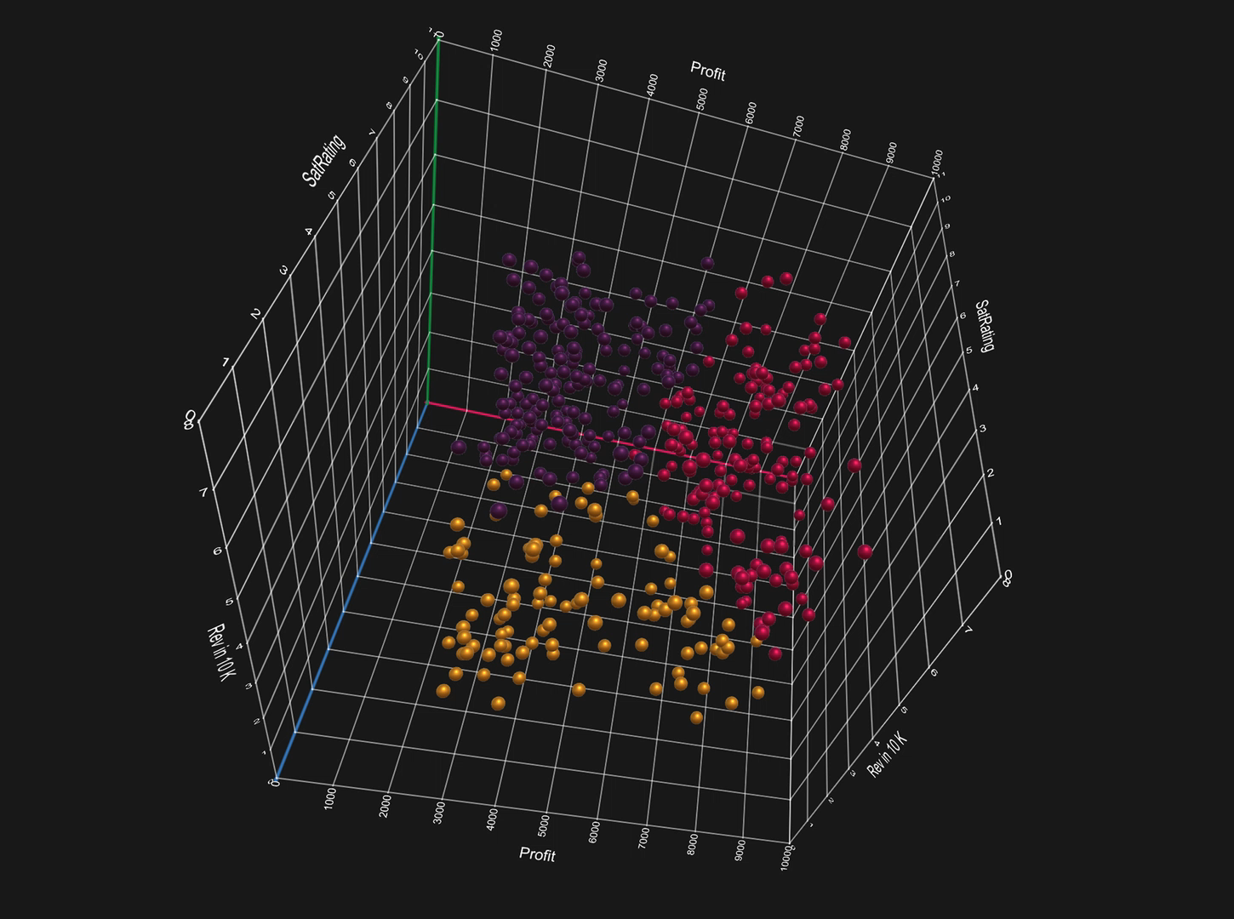
Other Cool Stuff
MS Charts 3D

Slide 20
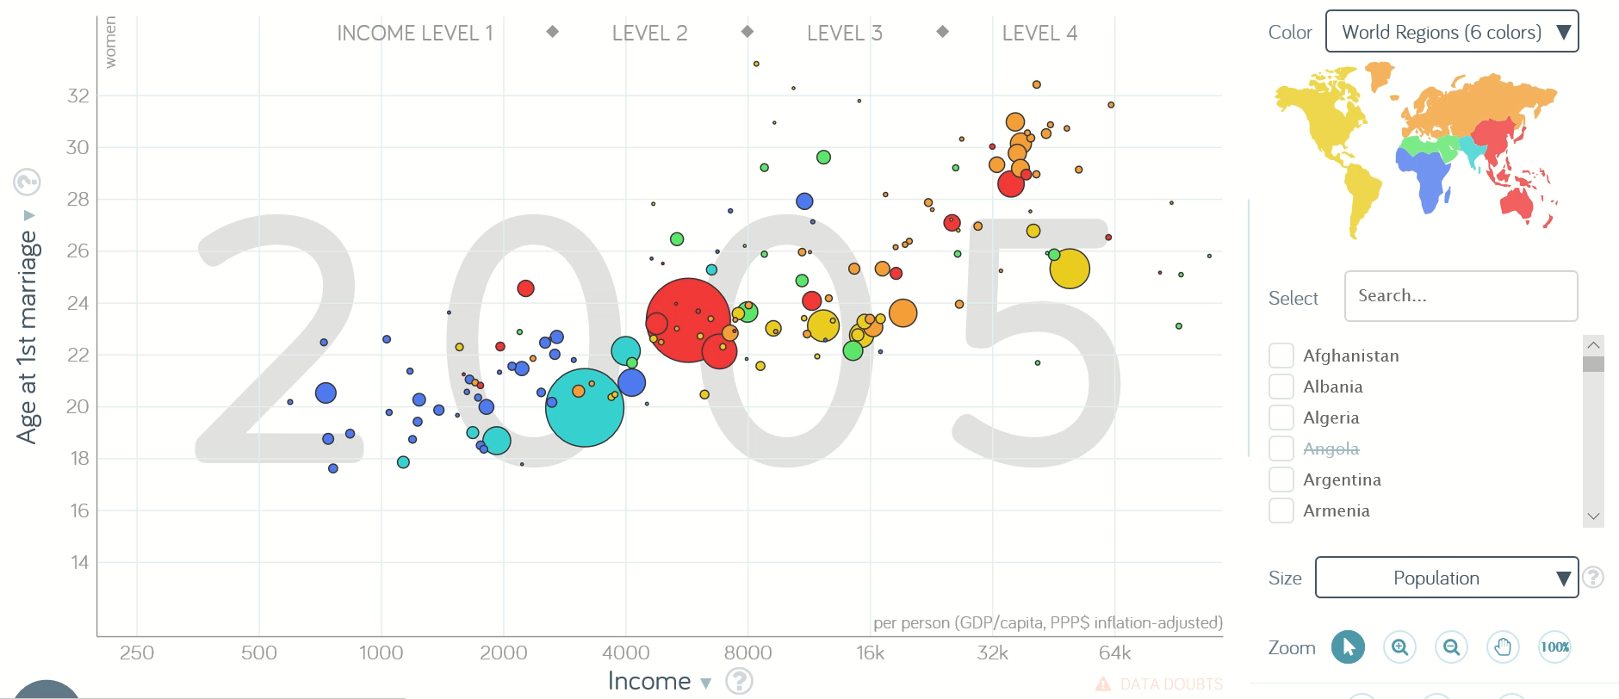
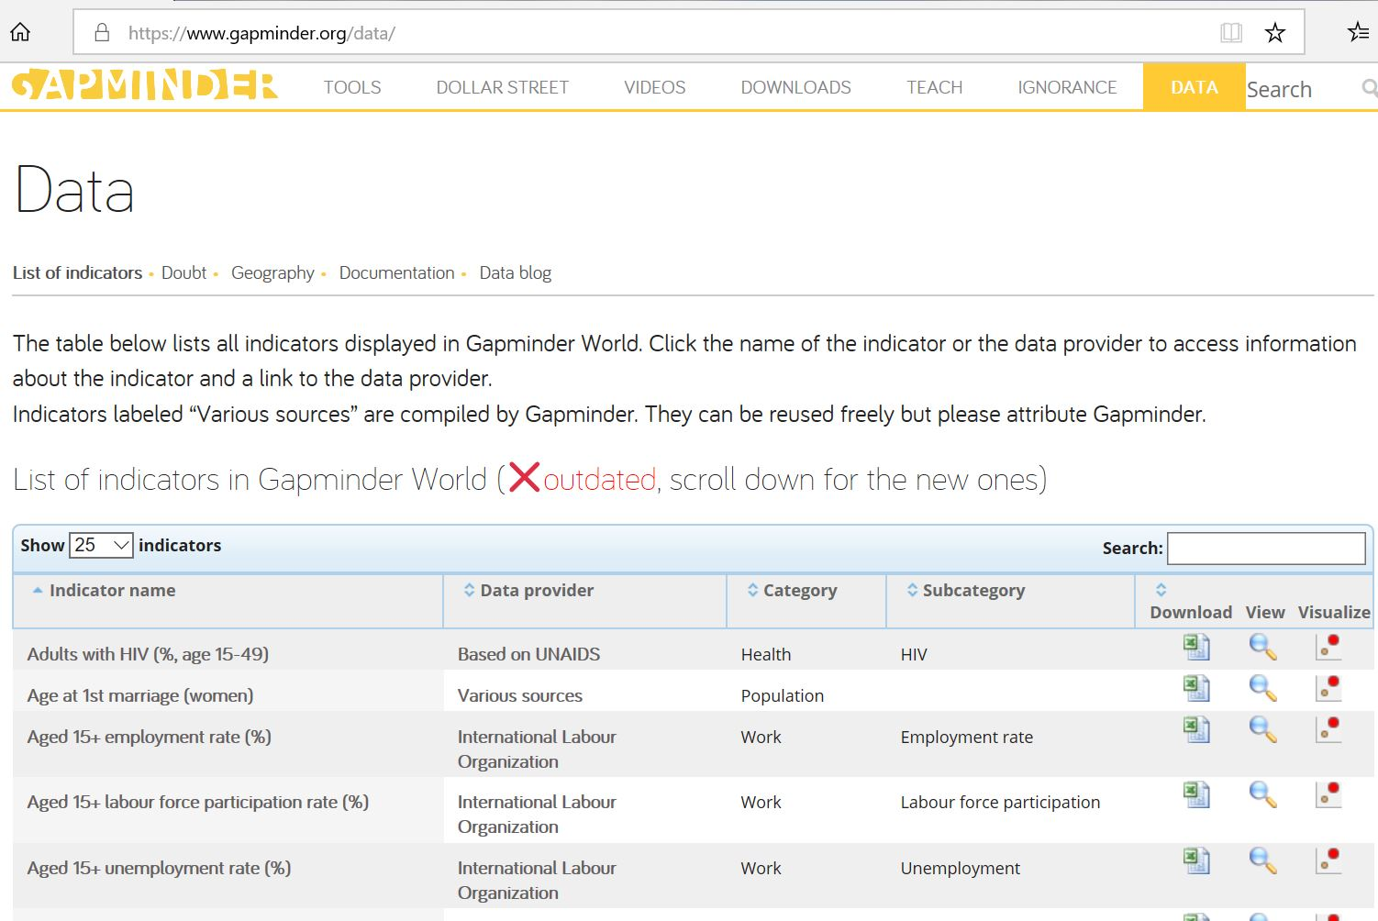

Other Cool Stuff
www.gapminder.org
Lot’s of data and interesting visualizations.

Slide 21


Introductory Background Ideas

Slide 22
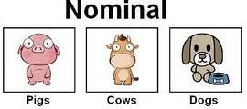
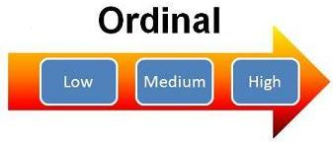
Data Classification
Categorical or Nominal (qualitative)
Data that results from counting, whole numbers.
Data are sorted into categories according to specified characteristics.
There is priority or ordering of categories.
Typically the number of observations in a category are counted up.
Ordinal
Similar to categorical or nominal data but the categories have a natural ordering.
Interval or Continuous (quantitative)
Data that results from measurement and has decimals.
There can always be another observation between two others.

Slide 23
Populations and Samples
μ
π

Slide 24
Very Important Idea! Standard Deviation
It is a measure of the dispersion, variability, or spread in a set of data.
In many business applications, it is an indicator of uncertainty or risk.
The standard deviation is like an “average” distance from a mean, but a bit larger.
Technically it is the square root of the average of squared distances from the mean.
A number (metric) that measures of the spread or dispersion in a data set.
The visual, graphical equivalent is a Histogram.
S
σ

Slide 25

Important Idea! Two Standard Deviations
Two (or more) standard deviations away is a long ways.
A change in a process of 2 or more SD’s is major.
Observations more than 2 SD’s from a mean are fairly rare.
Observations of more than 3 SD’s from a mean are very rare.
Note: Later, a Z value will be discussed. A Z value is how many standard deviations an observation is away from its mean. An observation’s Z value is a standardized measure, for data sets that are approximately normally distributed. Observations that have Z values of 2 or greater are far away from the mean.

Slide 26
Two Standard Deviations

Slide 27
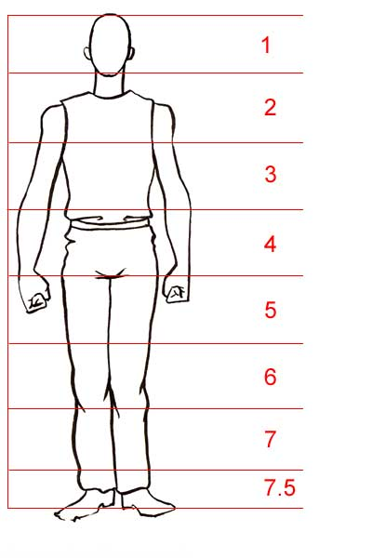
In General, Larger Samples Sizes Produce Better Performance in Our Analysis
Less chance for error
Higher confidence level in our results
n = 90
x = 71”
n = 3
x = 76”
N=5000
μ=72”

Slide 28
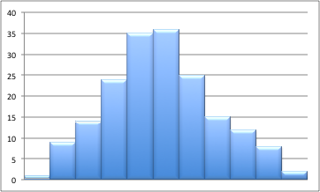
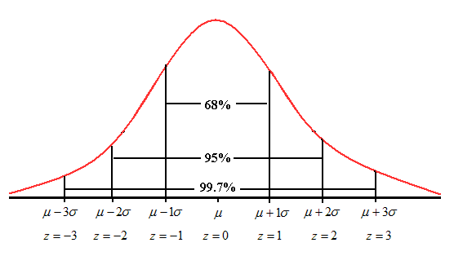
Normally Distributed Data

Slide 29
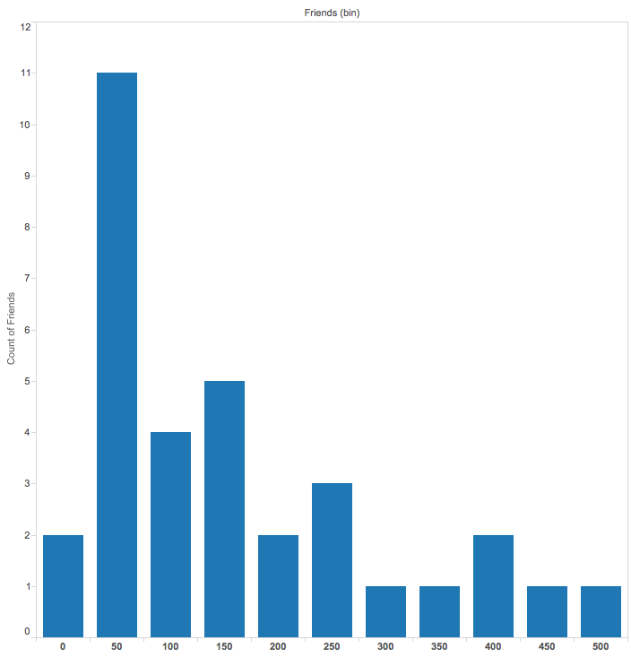
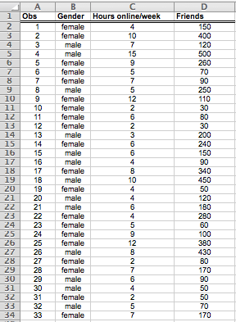

Not Normally Distributed Data

Slide 30
Simple Linear Regression
Statistical model / equation that comes up with a value (or estimate) for a dependent variable based on one predictor (or independent) variables.
Example: Estimating sales based on advertising expenditures.
Example: Stock’s Beta is the Slope.

Slide 31
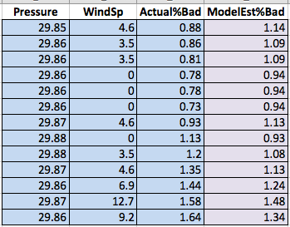
Multiple Regression
Statistical model / equation that comes up with a value (or estimate) for a dependent variable based on multiple predictor (or independent) variables.
Multiple predictors may be continuous or categorical.
Example estimating percentage of bad calls based on wind speed and barometric pressure.

Slide 32
Multiple Regression

Slide 33
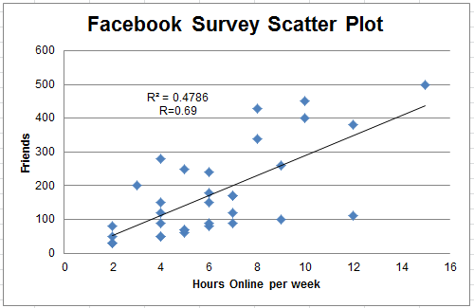
Correlation and R

Slide 34
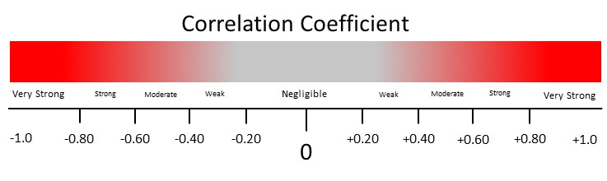
Correlation and R

Slide 35

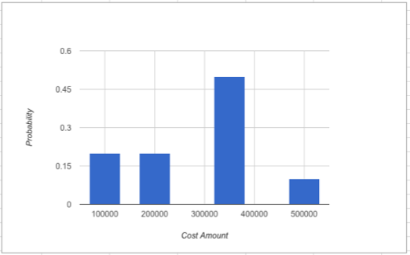
Common Probability Distributions
Uniform, specified with 2 numbers
Triangular, specified with 3 numbers
Normal, specified with 2 numbers
Custom Discrete, fixed limited buckets for outcomes

Slide 36
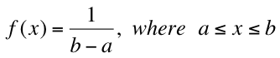
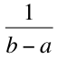
Common Probability Distributions Uniform
Two numbers specify the distribution, min and max
All outcomes in between are equally likely
f(x)
a
b
x
area = width x height = (b – a) x = 1

Slide 37
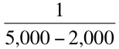
Common Probability Distributions Uniform
Amount (number of gallons) of gas sold daily at a service station
Min 2,000 gallons, Max 5,000 gallons
f(x)
2,000
5,000
x
Algebraically: what is P(2,500 ≤ X ≤ 3,000) ?

Slide 38
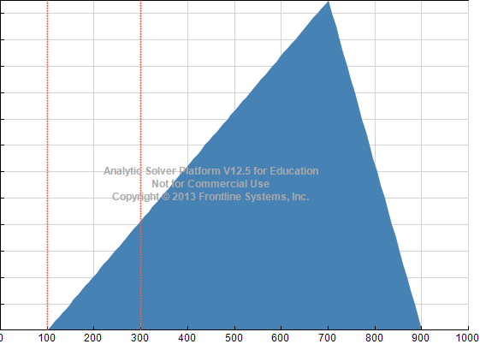
Common Probability Distributions Triangular
The Triangular Distribution is a very popular continuous distribution because it is easy to understand and use. It is defined/specified by three numbers, a minimum, maximum, and most likely. Outcomes near the most likely value have a higher chance of occurring than those near the extremes. The Triangular Distribution can be skewed in either direction.
Example: A project manager believes the completion times for a software development task will range between 100 hours and 900 hours with 700 hours being the most likely estimate. What is the probability the task will be completed between 100 and 300 hours?
f(x)=0.000833

Slide 39
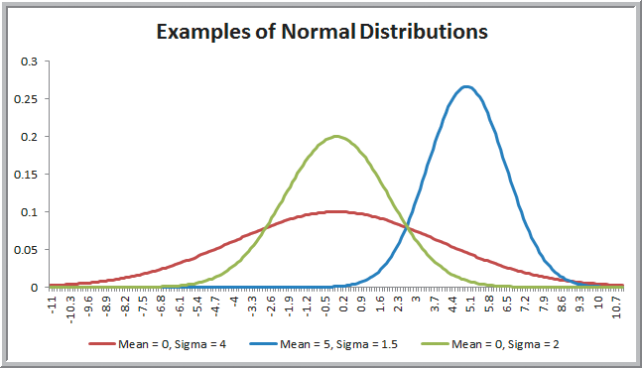
Common Probability Distributions Normal
Symmetric
Mean, Median are both in the middle
Probabilities are intervals under the curve
Many applications follow or nearly follow a bell shaped curve

Slide 40
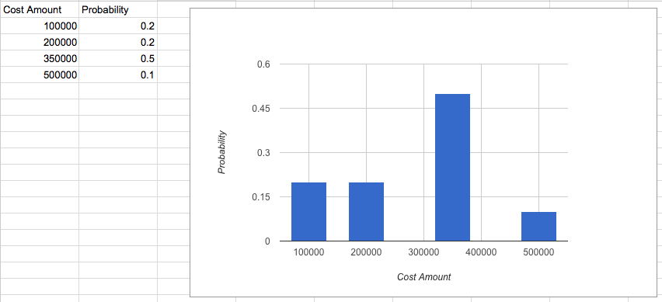
Common Probability Distributions Custom Discrete

Slide 41

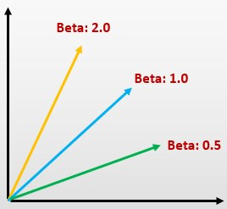

Business Analytics
First Experiment 1 of 2
$$β$$

Slide 42
Simple Linear Regression
Use the Google Colab link and download 5 years of monthly returns for AAPL.
Use Excel to generate the appropriate scatterplot. Add the trendline, R2, and equation.
Interpret the Beta for AAPL and the correlation coefficient.
Validate with Yahoo! Finance.

Slide 43


Simple Linear Regression
TSLA monthly returns
Beta 1.00
S&P 500 monthly returns

Slide 44
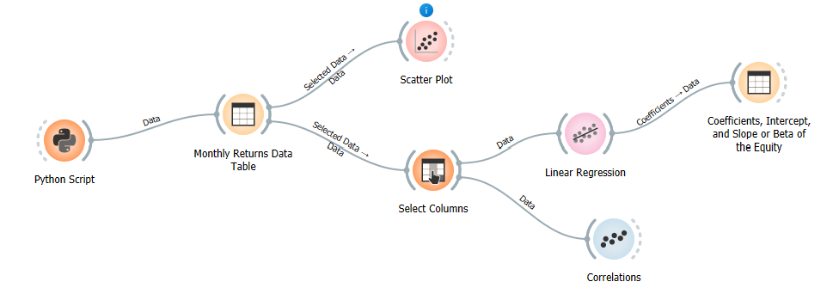
Simple Linear Regression
This Orange workflow is available at our class site 😃😃

Slide 45



Business Analytics
First Experiment 2 of 2

Slide 46
Multiple Regression Application
Workshop Exercise, Predictive Analytics, Frontline Data mining, Alteryx
MSAutos.xlsx
Supervised learning to predict automobile price from some attributes or predictors
Automobiles price data ⬅ dataset
We wish to develop a machined learning model
205 observations/rows each with 26 attributes/columns
We will use 4 predictors (wheel-base, engine-size, horsepower, city-mpg) from the dataset and one target (price)
Build and run using Orange Data Mining
Interpret the results

Slide 47
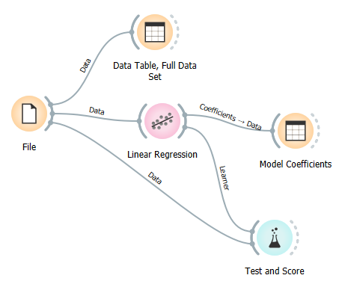
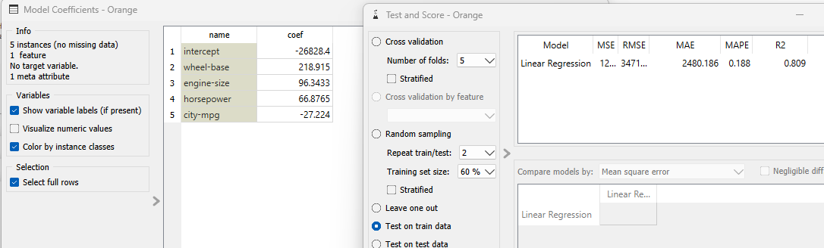

Multiple Regression Application

Slide 48
Summary of Background Needed to Study Business Analytics
A basic understanding of probability concepts.
Knowledge of common probability distributions (normal, uniform, triangular, discrete).
Understanding that for a continuous probability distribution, likelihoods/probabilities are areas under the curve.
The idea of a sample.
Conceptual idea of standard deviation.
Conceptual idea of correlation.
Conceptual idea of slope.
The difference between correlation and slope.
Basic and common data visualizations (scatter plots, line charts, bar charts).
Data types (categorical, continuous) or qualitative categories and numerical data (like float and double).
Standardizing numerical data, Z-scores or Z-values.
An ability to interpret a histogram. An understanding of skewness.
Excel and pivot tables.

